Slide 1

Monitoring Depth Of Anesthesia By Combining EEG And Body Vitals Using Neural Nets
Sudhanshu, Tanmai and Siddharth

Slide 2
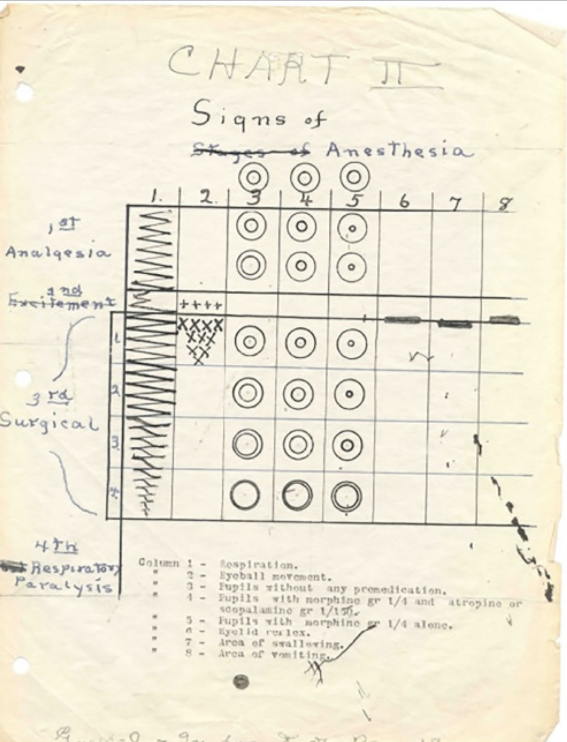
Why monitor Anaesthesia?
Underdosage can put the patient in pain and the reflex responses of the body can interfere with the medical procedure
Overdosage can cause a physiological 'shutdown', might be fatal
Older ways of
Guedel's Classification, 1920

Slide 3
Our Approach

Slide 4
The Data We Need

Slide 5
Data Preprocessing

Slide 6
Data Preprocessing – Spectral Interpolation

Slide 7
Data Processing

Slide 8
Hilbert Huang Entropy

Slide 9
Power Spectral Analysis

Slide 10
On To The Neural Network!
Artificial Neural Networks derive inspiration from neuroscience
The regression problem: We have a set of inputs; now we need a model to recognise its pattern
We turn to neural networks, the most adaptable way of solving a learning problem
Our Input Data: Two HH Entropy values, two approximate entropy values, alpha wave power, delta wave power, delta ratio and our body vitals – heart rate, respiratory rate and blood oxygen saturation. Our Output: Degree of Anaesthesia
W

Slide 11
Interpretation of Results

Slide 12
A Better Approach

Slide 13
In Conclusion,
Don't overdose on Anaesthesia!

Slide 14
Thank You!

